Slide 1

Classification and regression Using Supervised Learning
Artificial Intelligence with python

Slide 2
What is learning
Learning is a process that:
is active - process of engaging and manipulating objects, experiences, and conversations in order to build mental models of the world (Dewey, 1938; Piaget, 1964; Vygotsky, 1986).
Learners build knowledge as they explore the world around them, observe and interact with phenomena, converse and engage with others, and make connections between new ideas and prior understandings.
builds on prior knowledge - and involves enriching, building on, and changing existing understanding, where “one’s knowledge base is a scaffold that supports the construction of all future learning” (Alexander, 1996, p. 89).
occurs in a complex social environment - and thus should not be limited to being examined or perceived as something that happens on an individual level.
it is necessary to think of learning as a social activity involving people, the things they use, the words they speak, the cultural context they’re in, and the actions they take (Bransford, et al., 2006; Rogoff, 1998), and that knowledge is built by members in the activity (Scardamalia & Bereiter, 2006).
is situated in an authentic context - provides learners with the opportunity to engage with specific ideas and concepts on a need-to-know or want-to-know basis (Greeno, 2006; Kolodner, 2006).
requires learners’ motivation and cognitive engagement to be sustained when learning complex ideas, because considerable mental effort and persistence are necessary.

Slide 3
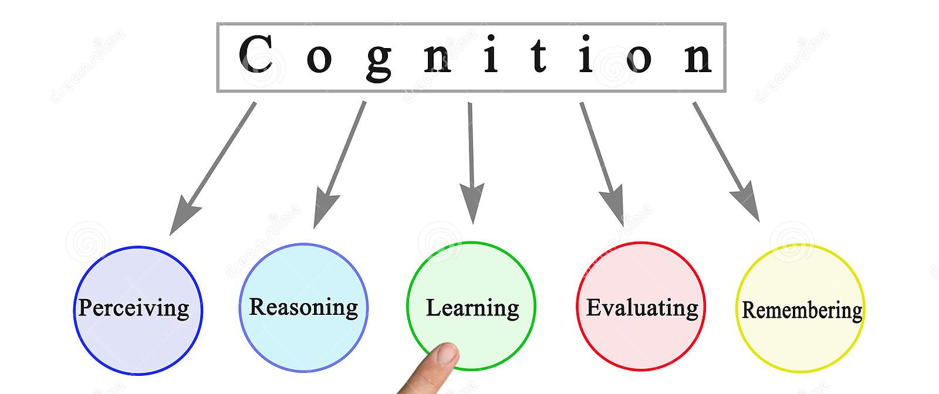
Cognition

Slide 4
machine learning
Cognition: the mental action or process of acquiring knowledge and understanding through thought, experience, and the senses.
Machine learning focuses on the use of data and algorithms to imitate the way that humans learn, gradually improving its accuracy
Through the use of statistical methods, algorithms are trained to make classifications or predictions, uncovering key insights within data mining projects
These insights subsequently drive decision making within applications and businesses, ideally impacting key growth metrics.
As big data continues to expand and grow, the market demand for data scientists will increase, requiring them to assist in the identification of the most relevant business questions and subsequently the data to answer them.

Slide 5
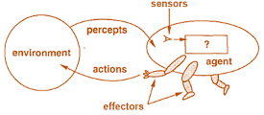
Intelligent Agent
Intelligent Agents can be any entity or object like human beings, software, machines.
These agents can make decisions based on the inputs from the environment using its sensors and act on the environment using actuators.
AI-Enabled agents collect input from the environment by using sensors like cameras, microphones or other sensing devices.
The agents perform some real-time computation on the input and deliver output using actuators like screens or speakers.
These agents have abilities like Real-Time problem solving, Error or Success rate analysis and information retrieval.

Slide 6

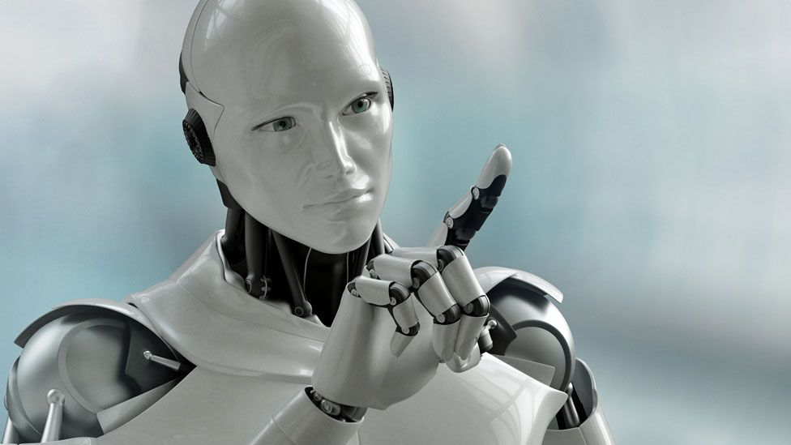
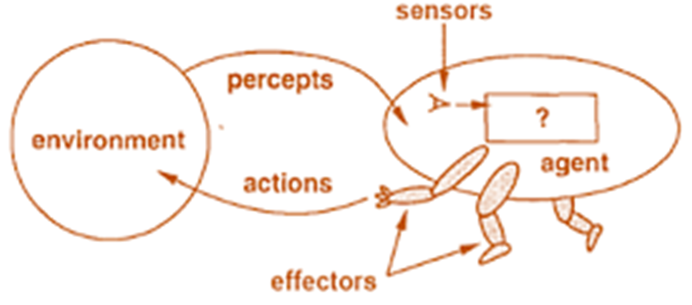
Intelligent agents
Human-Agent: A Human-Agent use Eyes, Nose, Tongue and other sensory organs as sensors to percept information from the environment and uses limbs and vocal-tract as actuators to perform an action based on the information
Robotic Agent: Robotics Agent uses cameras and infrared radars as sensors to record information from the Environment.
It uses reflex motors as actuators to deliver output back to the environment.
Software Agent: Software Agents use keypad strokes, audio commands as input sensors and display screens as actuators.

Slide 7
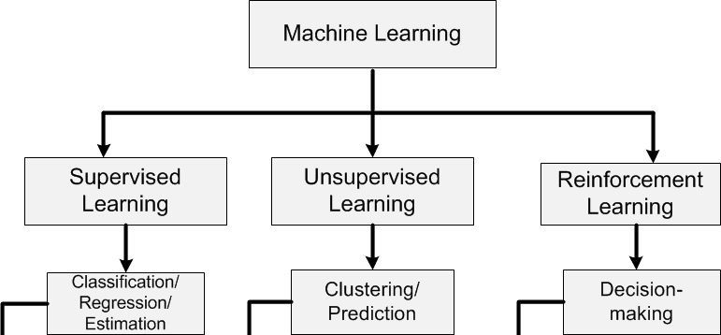
Machine learning types

Slide 8
Unsupervised learning (UL)
A model must look for patterns in a dataset with no labels and with minimal human supervision
Another name for unsupervised learning is knowledge discovery.
Common unsupervised learning techniques include clustering, and dimensionality reduction
In UL, a dataset is provided without labels where a model learns useful properties of the structure of the dataset
We do not tell the model what it must learn, but allow it to find patterns and draw conclusions from the unlabeled data
The algorithms in unsupervised learning are more difficult than in supervised learning, since we have little or no information about the data.
Unsupervised learning tasks typically involve grouping similar examples together

Slide 9
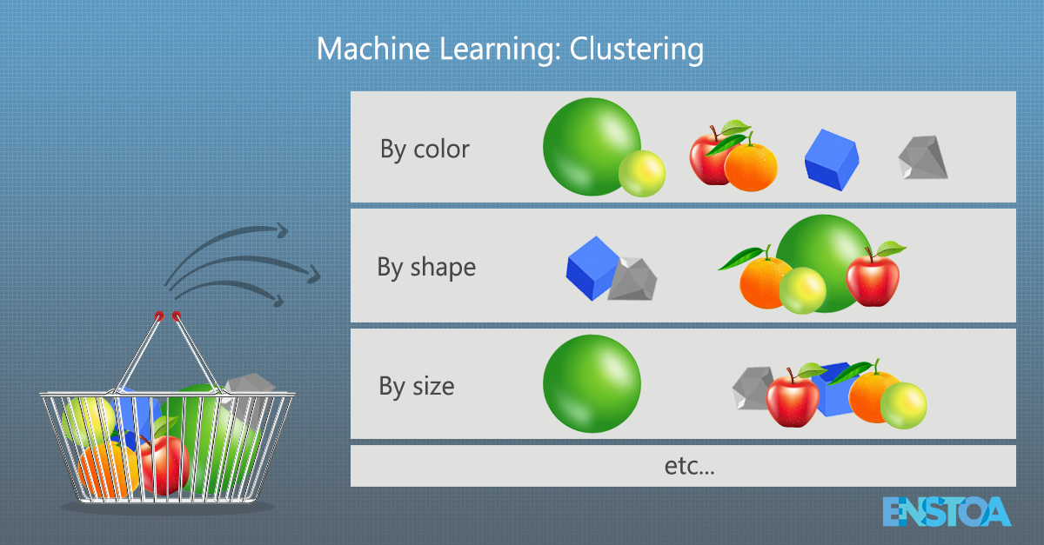
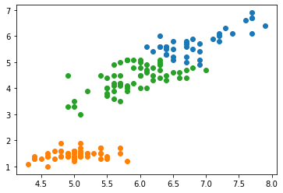
Unsupervised learning (clustering)

Slide 10
Supervised learning
The process of building a machine learning model that learns from labeled training data
Example: Income prediction system which is based on various parameters i.e. age, education, location, and so on.
We need to create a database of people with all the necessary details and label it
Lebelling: We tell our algorithm what parameters correspond to what income.
Based on this mapping, the algorithm will learn how to calculate the income of a person using the parameters provided to it

Slide 11
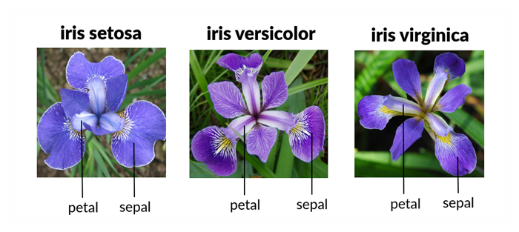
Iris flower dataset

Slide 12
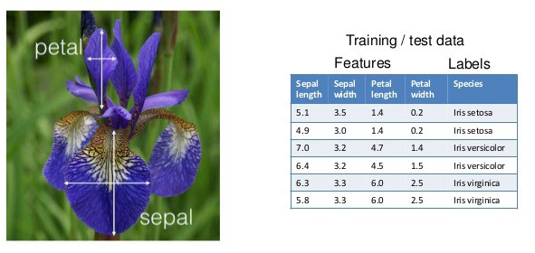
Supervised learning – iris flower dataset

Slide 13
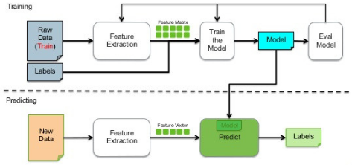
Supervised learning

Slide 14


Classification
In classification we group data into already decided number of classes
We build the classification model based on the training dataset containing data points and the corresponding labels
Let we want to check whether the given image contains a person's face or not.
Build a training dataset containing images of face and no-face
Train the model based on the training samples
The trained model is then used for inference
Classification is used extensively in face recognition, spam identification, recommendation engines, and so on.
The algorithms for data classification will find the right criteria to separate the given data into the given number of classes

Slide 15
Classification steps
Define the Classes
Create Dataset
Preprocess
Create Model
Train Model
Test Model

Slide 16
Data preprocessing
Lot of raw data is available in the real world
Machine learning algorithms expect data to be formatted in a certain way before training
To prepare the data to feed to machine learning algorithms, conversion to right format is required
Some preprocessing Methods
Binarization
Mean Removal
Scaling
Normalization
import numpy as np from sklearn import preprocessing
input_data = np.array([[5.1, -2.9, 3.3],
[-1.2, 7.8, -6.1],
[3.9, 0.4, 2.1],
[7.3, -9.9, -4.5]])

Slide 17
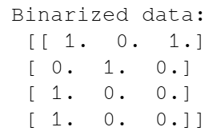
Binarization`1
The process of converting numerical values to Boolean values
# Binarize data data_binarized = preprocessing.Binarizer(threshold=2.1).transform(input_data) print("\nBinarized data:\n", data_binarized)

Slide 18
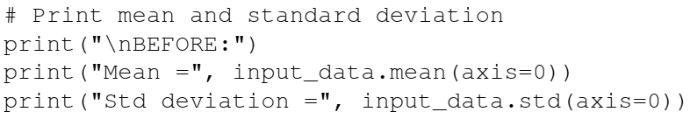
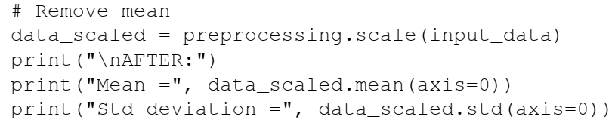
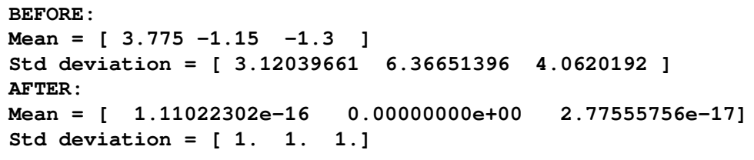
Mean removal
to remove the mean from our feature vector, so that each feature is centered on zero.
We do this in order to remove bias from the features in our feature vector

Slide 19
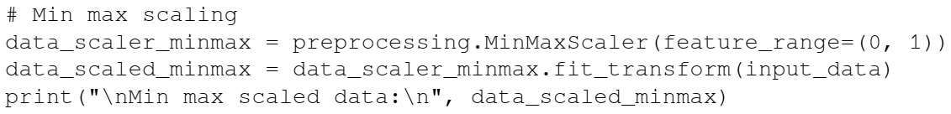
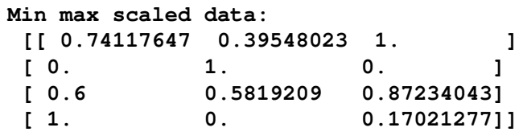
scaling
The value of each feature can vary between many random values.
It becomes important to scale those features to make learning process better and efficient
We don't want any feature to be artificially large or small just because of the nature of the measurements

Slide 20


normalization
Normalization is used to modify the values in the feature vector so that we can measure them on a common scale.
A number of normalization methods are used
L1 normalization (Least Absolute Deviations): refers to works by making sure that the sum of absolute values is 1 in each row.
This technique is considered more robust than L2 normalization being resistant to outliers.
L2 normalization: refers to least squares, works by making sure that the sum of squares is 1.
$$L1 norm: {\left\|w\right\|}_{1}=\sum_{i}^{n}{\left|w_{i}\right|}$$
$$Squared L2 norm: {\left\|w\right\|}_{2}^{2}=\sum_{i}^{n}{\left|w_{i}\right|}$$

Slide 21
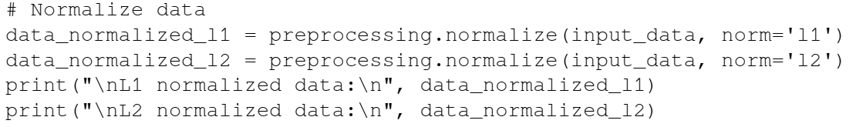
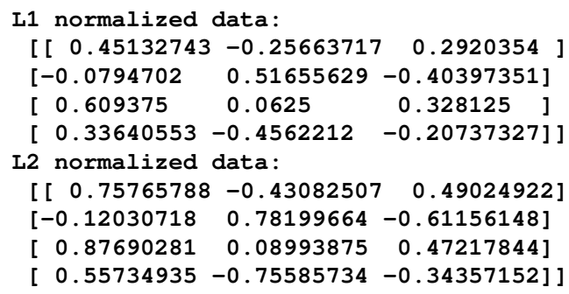
normalization

Slide 22
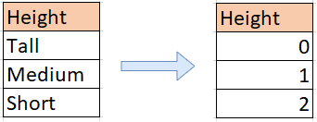
Label encoding
These labels of data can be in the form of words, numbers, or something else
The machine learning functions in sklearn library expect them to be numbers
If they are already numbers, then we can use them directly to start training.
Label encoding refers to the process of transforming the word labels into numerical form
To convert word labels into numbers, label encoder is used in sklearn

Slide 23
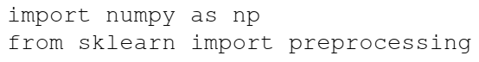
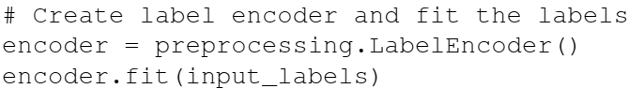
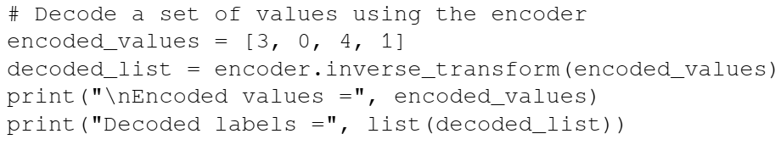
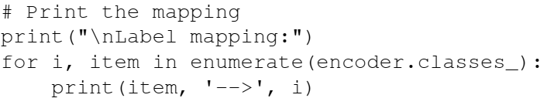
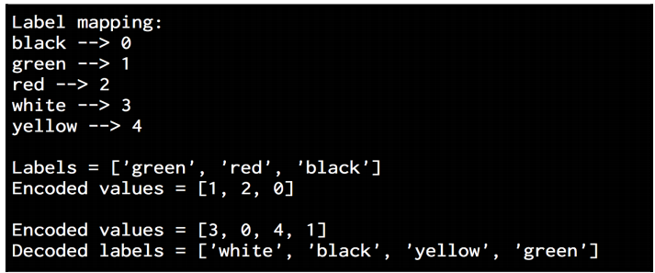
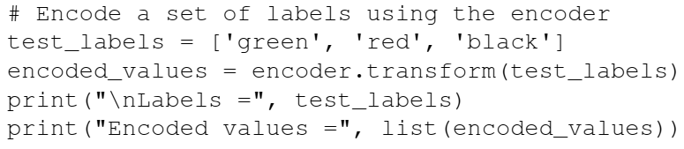
Label encoding

Slide 24
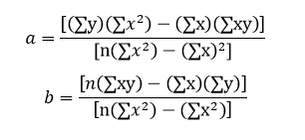
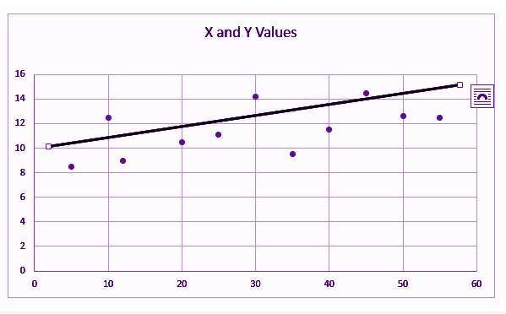
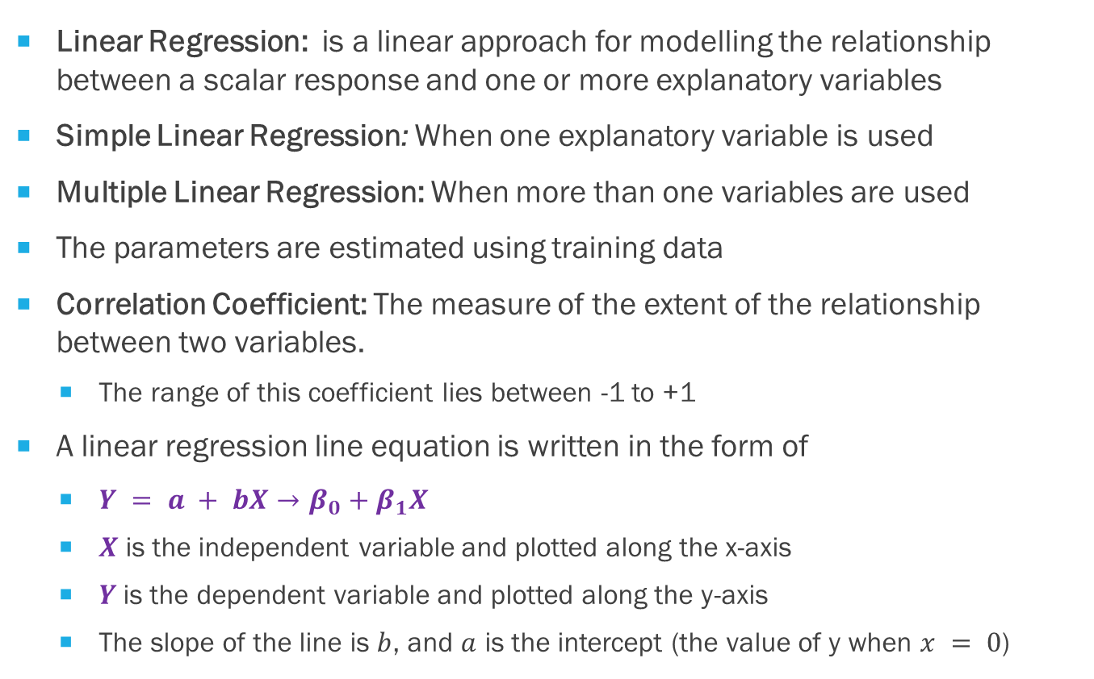
Linear regression
Linear Regression: is a linear approach for modelling the relationship between a scalar response and one or more explanatory variables
Simple Linear Regression: When one explanatory variable is used
Multiple Linear Regression: When more than one variables are used
The parameters are estimated using training data
Correlation Coefficient: The measure of the extent of the relationship between two variables.
The range of this coefficient lies between -1 to +1
A linear regression line equation is written in the form of
$Y = a + bX→β_{0}+β_{1}X$
$X$ is the independent variable and plotted along the x-axis
$Y$is the dependent variable and plotted along the y-axis
The slope of the line is $b$, and $a$ is the intercept (the value of y when $x = 0$)

Slide 25
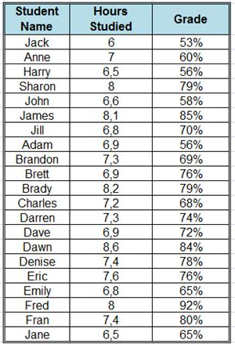
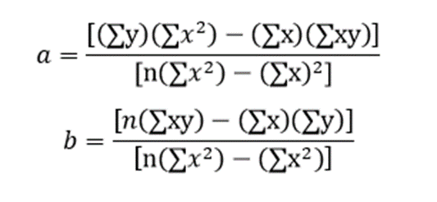
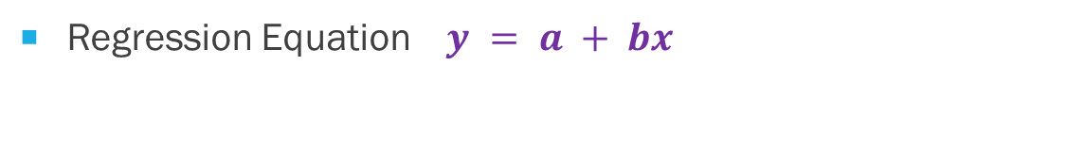
Linear regression example
Regression Equation $y = a + bx$

Slide 26
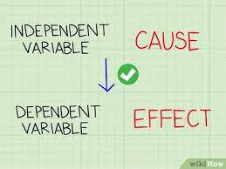
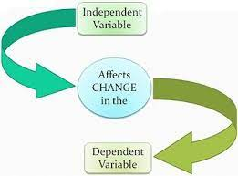
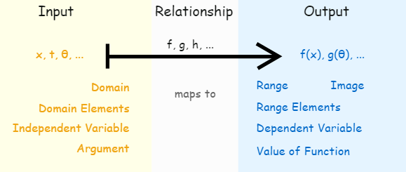
Logistic Regression classifier
Used to explain the relationship between input variables and output variables
Independent Variable: Input variables
Dependent Variable: Output variable
The dependent variable can take only a fixed set of values.
These values correspond to the classes of the classification problem
Goal: Identify the relationship by estimating the probabilities using a logistic function

Slide 27

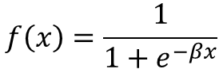
Logistic function
Logistic function is a sigmoid curve that's used to build the function with various parameters
It is very closely related to generalized linear model analysis, where we try to fit a line to a bunch of points to minimize the error.
Instead of using linear regression, we use logistic regression.
Logistic regression is actually not a classification technique, but we use it in this way so as to facilitate classification.
$$f\left(x\right)=\frac{1}{1+e^{−βx}}$$

Slide 28
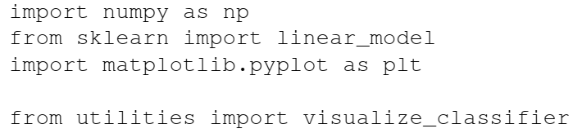
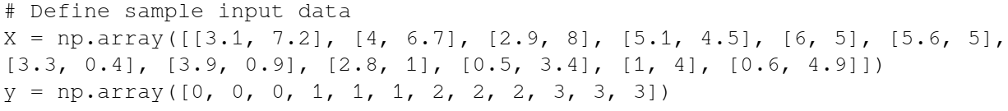
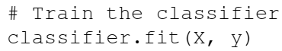
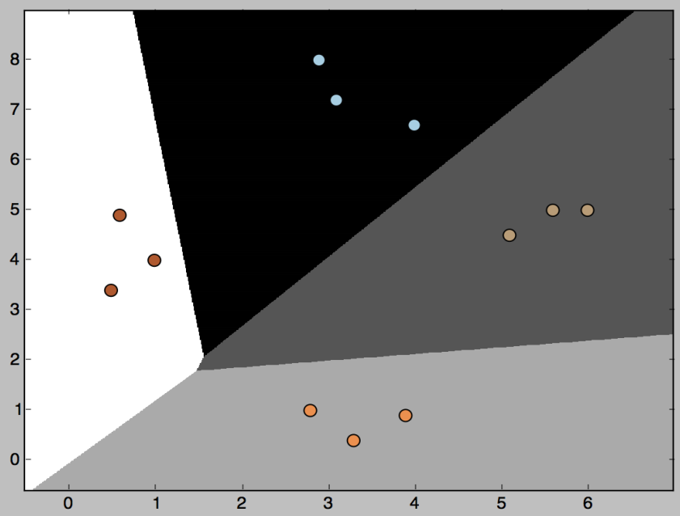
Logistic regression

Slide 29
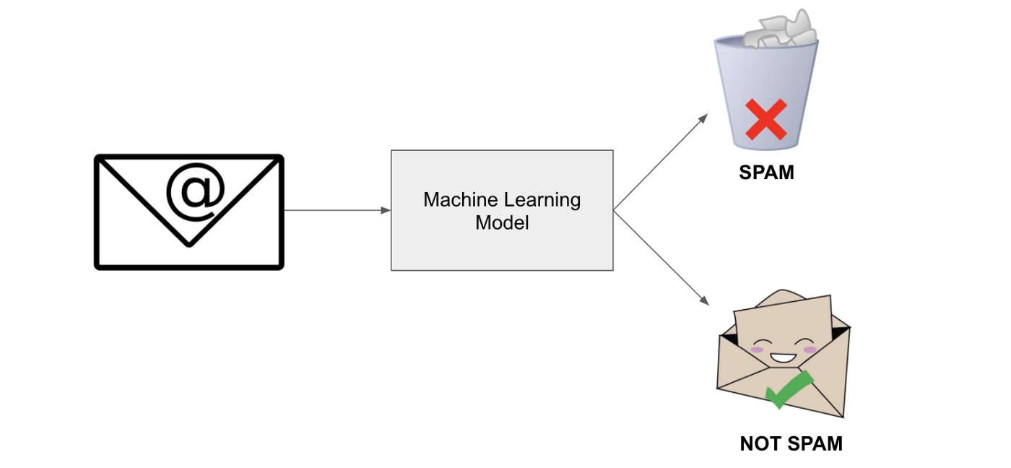
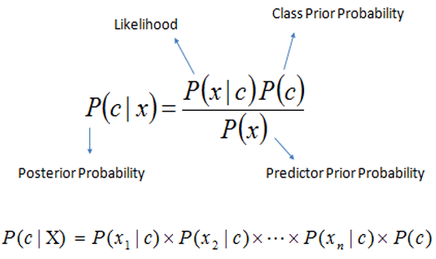
Naïve Bayes classifier
Naïve Bayes: A technique used to build classifiers using Bayes theorem.
Bayes theorem describes the probability of an event occurring based on different conditions that are related to this event

Slide 30
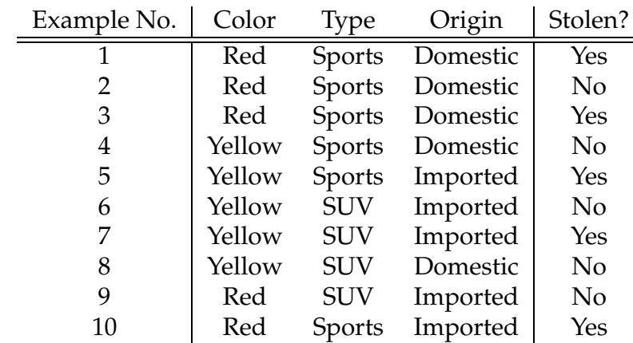
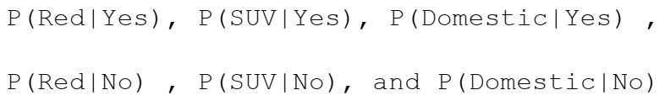
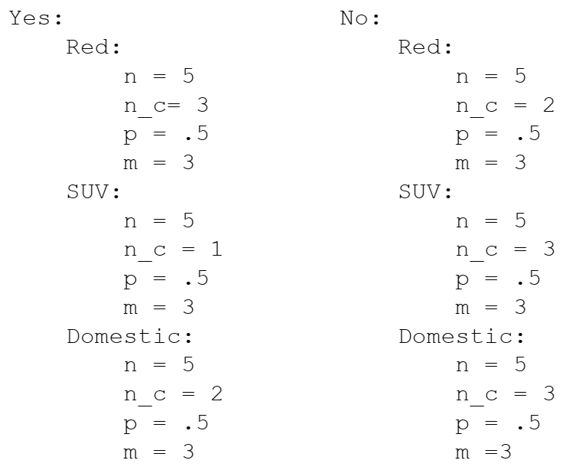
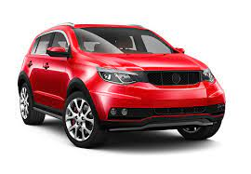
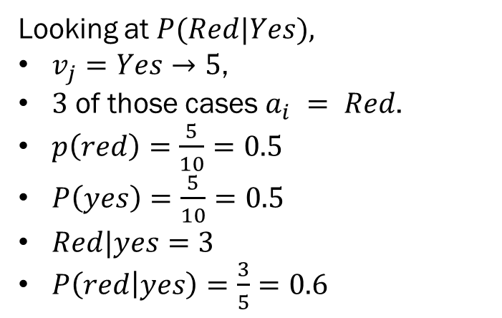
NB Example
Classify a Red Domestic SUV.
Note there is no example of a Red Domestic SUV in our data set
We need to calculate the probabilities and multiply them by P(Yes) and P(No) respectively
Looking at $P(Red|Yes),$
$v_{j}=Yes→5$,
$3$ of those cases $a_{i} = Red$.
$p\left(red\right)=\frac{5}{10}=0.5$
$P\left(yes\right)=\frac{5}{10}=0.5$
$Red|yes=3$
$P\left(red | yes\right)=\frac{3}{5}=0.6$

Slide 31
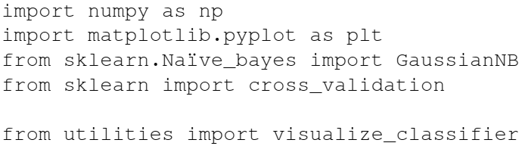
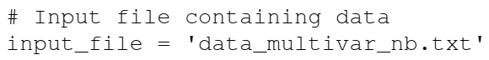
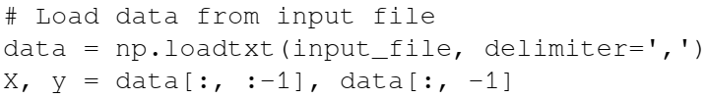
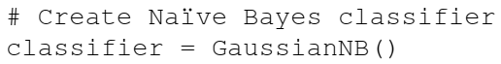



Naïve bayes in python

Slide 32

Cross validation
Train on one part of data and test of remaining part

Slide 33


Cross validation
Split the data into training and testing subsets
we will allocate 80% for training and the remaining 20% for testing

Slide 34

Cross validation

Slide 35


Cross validation results

Slide 36

Confusion matrix
A table that is used to describe the performance of a classifier
It is usually extracted from a test dataset for which the ground truth is known
We compare each class with every other class and see how many samples are misclassified
Several key metrics are derived from confusion table
True positives: These are the samples for which we predicted 1 as the output and the ground truth is 1 too
True negatives: These are the samples for which we predicted 0 as the output and the ground truth is 0 too.
False positives: These are the samples for which we predicted 1 as the output but the ground truth is 0. This is also known as a Type I error.
False negatives: These are the samples for which we predicted 0 as the output but the ground truth is 1. This is also known as a Type II error.

Slide 37

Metrics derived from confusion matrix
$$Accuracy=\frac{TP+TN}{TP+TN+FP+FN}=\frac{correct predictions }{total predictions}$$
Accuracy: Measures how often the classifier makes the correct prediction.
It’s the ratio between the number of correct predictions and the total number of predictions

Slide 38
Metrics derived from confusion matrix
$$Precision=\frac{TP}{TP+FP}=\frac{actually positive predictions}{Total positive prediction}$$
Precision: It is a measure of correctness that is achieved in true prediction. It tells us how many predictions are actually positive out of all the total positive predicted.

Slide 39

Metrics derived from confusion matrix
$$Recall=\frac{TP}{TP+FN}=\frac{Predicted actually positive}{total actual positives}$$
Recall (TPR, Sensitivity): Measure of actual observations which are predicted correctly, i.e. how many observations of positive class are actually predicted as positive.
Recall is a valid choice of evaluation metric when we want to capture as many positives as possible.

Slide 40




Metrics derived from confusion matrix
$$Recall=\frac{TP}{TP+FN}$$
$$Precision=\frac{TP}{TP+FP}$$
$$F1−score=\frac{2∗recall∗precision}{recall+precision}$$
F1-Score: The F1 score is a number between 0 and 1 and is the harmonic mean (HM) of precision and recall as HM is not sensitive to extremely large values, unlike simple averages.
F1 score sort of maintains a balance between the precision and recall for your classifier. If your precision is low, the F1 is low and if the recall is low again your F1 score is low.

Slide 41



Metrics derived from confusion matrix
$$FPR=\frac{FP}{FP+TN}$$
FPR (Type I Error): the probability of falsely rejecting the null hypothesis for a particular test.
FNR (Type II Error):
$$FNR=\frac{FN}{TP+FN}$$

Slide 42



CM based measures

Slide 43



CM based metrics

Slide 44

Support Vector Machines
A classifier that is defined using a separating hyperplane between the classes.
This hyperplane is the N-dimensional version of a line.
Given labeled training data and a binary classification problem, the SVM finds the optimal hyperplane that separates the training data into two classes.
This can easily be extended to the problem with N classes.

Slide 45


Linear Classifiers
α
x
f
y^{est}
$$f(x,w,b) = sign(w. x − b)$$

Slide 46

Vapnik–Chervonenkis (VC) dimension
Def: If there exists (not any set) a set of $n$ points that can be shattered (classified) by the classifier and there is no set of $n+1$ points that can be shattered by the classifier, then the VC dimension of the classifier is $n$
If a classifier's VC dimension is 3, it does not have to shatter all possible arrangements of 3 points
If of all arrangements of 3 points you can find at least one such arrangement that can be shattered by the classifier, and cannot find 4 points that can be shattered, then VC dimension is 3

Slide 47

An example of VC dimension
Suppose our model class is a hyperplane.
In 2-D, we can find a plane (i.e. a line) to deal with any labeling of three points. A 2-D hyperplane shatters 3 points
But we cannot deal with some of the possible labelings of four points.
A 2-D hyperplane (i.e. a line) does not shatter 4 points

Slide 48

Support vector machines
The line that maximizes the minimum margin is a good bet
The model class of “hyper-planes with a margin of m” has a low VC dimension if m is big
This maximum-margin separator is determined by a subset of the data points.
Data points in this subset are called “support vectors”.
It will be useful computationally if only a small fraction of the data points are support vectors, because we use the support vectors to decide which side of the separator a test case is on.

Slide 49

Training a linear SVM
To find the maximum margin separator, we have to solve the following optimization problem:
This is tricky but it’s a convex problem. There is only one optimum and we can find it without fiddling with learning rates or weight decay or early stopping.
Don’t worry about the optimization problem. It has been solved. Its called quadratic programming.
It takes time proportional to $N^{2}$ which is really bad for very big datasets
so for big datasets we end up doing approximate optimization!

Slide 50


Slide 51
Testing a linear SVM
The separator is defined as the set of points for which:

Slide 52

Example - svm
Let's consider a two-dimensional case with two classes of points.
Given that it's 2D, we only have to deal with points and lines in a 2D plane.
This is easier to visualize than vectors and hyperplanes in a high-dimensional space.
There are two classes and we want to find the optimal hyperplane to separate the two classes
In this picture, the solid line represents the best hyperplane
You can draw many different lines to separate the two classes of points, but this line is the optimal, because it maximizes the distance of each point from the separating line.
The points on the dotted lines are called Support Vectors.
The perpendicular distance between the two dotted lines is called maximum margin

Slide 53

What is Regression?
Regression is the process of estimating the relationship between input and output variables
Output variables are continuous-valued real numbers so there are an infinite number of possibilities
Whereas the number of output classes is fixed (finite set)

Slide 54




Single variable regressor

Slide 55





Slide 56



Slide 57




Slide 58




Multivariable regressor

Slide 59



Slide 60





Slide 61




Estimating housing prices using a Support Vector Regressor

Slide 62




Slide 63

Linear Regression
In linear regression, we assume that the relationship between input and output is linear. This puts a constraint on our modeling procedure, but it's fast and efficient.
Sometimes, linear regression is not sufficient to explain the relationship between input and output.

Slide 64
Polynomial Regression
We use polynomial regression, where we use a polynomial to explain the relationship between input and output.
This is more computationally complex, but gives higher accuracy. Depending on the problem at hand, we use different forms of regression to extract the relationship.
Regression is frequently used for prediction of prices, economics, variations, and so on.

